Slide 1
Upper Basin Consumptive Use
Overestimation impacts on the 2007 Interium Guidelines

Slide 3
Randy Seaholm Memo - November 13-15, 2006

Slide 4
Article III(a)
Exclusive Beneficial Consumptive Use .vs. Demand Management

Slide 5
1922 Colorado Compact - Article III
There is hereby apportioned from the Colorado River System in perpetuity to the Upper Basin and to the Lower Basin, respectively, the exclusive beneficial consumptive use of 7,500,000 acre-feet of water per annum, which shall include all water necessary for the supply of any rights which may now exist.

Slide 6
The “Greed” part of “Fear and Greed”
Meeting the Financial Challenges of Improved Water Management in the West Peter Fleming (Colorado River District), Getches Wilkinson - September 2020
“The compact prohibits the Interbasin transfer of water, that’s quite clear that the 1922 compact allocates water to the Upper Basin for its exclusive use and it allocates water to the Lower Basin for it’s exclusive use and never the two shall intertwine. And whereas Demand Management is not a change of a water right for use in the Lower Basin there is a theory at least that if private investment is investing in agricultural lands for the purpose of the water in part, you know maybe that is just part of their investment strategy, that the economic forces from the Lower Basin to encourage the non use of water in the Upper Basin in order to secure the supplies of the Lower Basin could be so great as to make it impossible for a private investor who is seeking the highest economic return, to resist those economic forces from the Lower Basin so that they would accept payment from the Lower Basin as opposed to payment from Upper Basin interests to simply not use the water. Now is that a transfer prohibited by the compact, I don’t know, I know it gets closer to such a thing than I would prefer.

Slide 7
Gravity Works
CRWUA Lower Basin Panel 2018
John Entsminger (SNVWA): “The Law of the River isn't carved on stone tablets. Right... just since we sat up here last year we've learned not to disincentivize the Upper Basin from putting water into Lake Powell. Right, We're like The Law of the River says... you know blah, blah, blah....who cares...they want to put water into Lake Powell. Guess what, gravity works, eventually it's coming to us.
(Laughter)
“We need to be flexible.”

Slide 8
1922 Colorado Compact - Article III(a)
Getches 40th Summer Conference
John Entsminger(SNWA) proposes Lower Basin ICS in Lake Powell
Erik Kuhn concurs
Tom Buschatzke (Arizona DWR) wasn’t happy.
Kathryn Sorenson (Phoenix water) proposes ICS in Ruedi.
Much truth is said in jest.

Slide 9
1922 Colorado Compact - Article VIII
Present perfected rights to the beneficial use of waters of the Colorado River System are unimpaired by this compact.
Whenever storage capacity of 5,000,000 acre-feet shall have been provided on the main Colorado River within or for the benefit of the Lower Basin, then claims of such rights, if any, by appropriators or users of water in the Lower Basin against appropriators or users of water in the Upper Basin shall attach to and be satisfied from water that may be stored not in conflict with Article III.
All other rights to beneficial use of waters of the Colorado River System shall be satisfied solely from the water apportioned to that Basin in which they are situate.

Slide 10
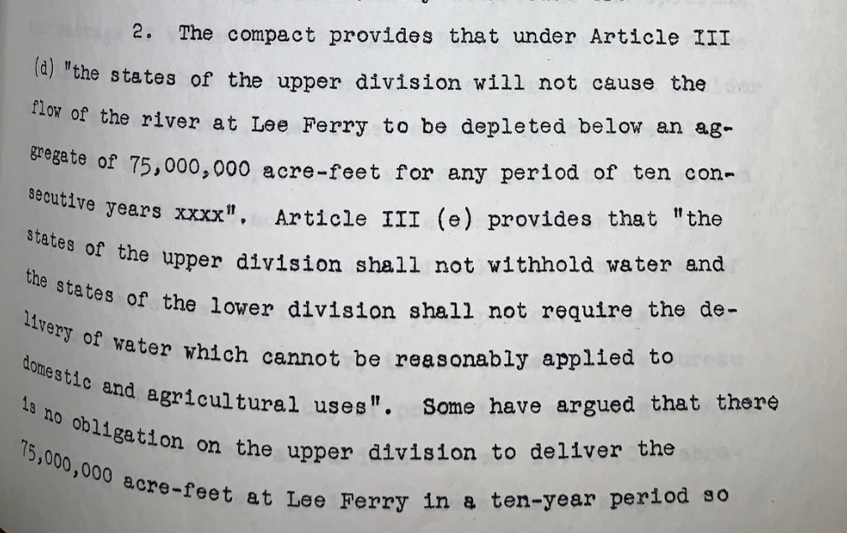
Royce Tipton Memo

